Slide 1
OPTIMIZATION OF KIT ITEM DISTRIBUTION

Slide 2

PROJECT LEADERSHIP
MENTOR BY:
SHIVA
DONE BY:
SANTHOSH.K

Slide 3

CONTENTS
Business objective & Constraint
Project Architecture
Business Problem
CRISP ML(q)
Data Collection
Data Understanding
Data Information
Data Dictionary
System Requirements
Exploratory Data Analysis(Before, After)
Data Preprocessing
Data Visualization
Challenges
Future Scope
Thank you

Slide 4



BUSINESS OBJECTIVE AND CONSTRAINT
Business objective:
Maximize efficient kit delivery
Business constraint:
Maximize the supply consistency

Slide 5
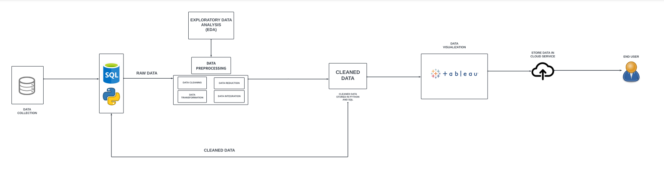
PROJECT OVERVIEW & SCOPE
PROJECT ARCHITECTURE

Slide 6
BUSINESS PROBLEM
A Leading automotive manufacturer , facing difficulties in efficient sourcing and providing unique kit items from various vendors to meet customer demands

Slide 7
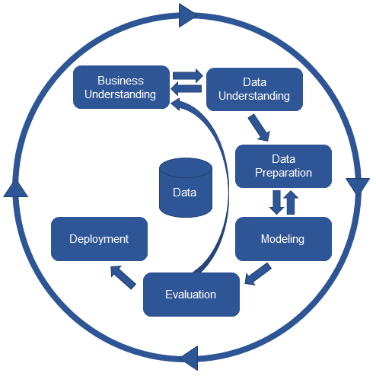
CRISP ML-Q METHODOLOGY
There are six stages of CRISP-ML(Q) Methodology
1.Business and data understanding
2.Data preparation
3.model building
4.Model evaluation
5.Model deployment
6.Monitoring and maintenance

Slide 8

DATA COLLECTION
Data collection is the process of gathering and capturing information from various sources to be used for analysis, research, or decision-making. The quality and reliability of the collected data play a crucial role in the outcomes of any analysis or project.
FILE READING
Use libraries like PANDAS for reading data from files such as CSV, Excl, JSON, etc.
CODE
import pymysql
from sqlalchemy import create_engine
import pandas as pd
kit = pd.read_csv(r"C:\Users\MY PC\Desktop\360 project 2\kit.csv")
print(kit)

Slide 9
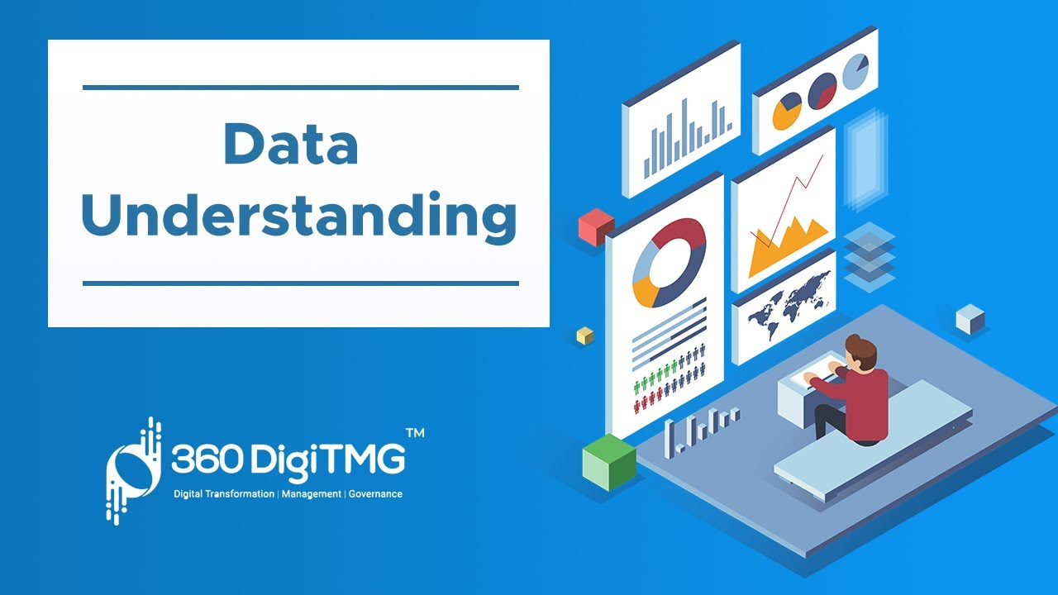
DATA UNDERSTANDING
Data understanding is a critical phase in the data analysis process. It involves exploring and gaining insights into the characteristics, structure, and content of the dataset. This phase helps analysts and data scientists become familiar with the data, identify patterns, and make informed decisions about how to proceed with analysis.
TYPES OF DATA UNDERSTANDING:
EXPLORATORY DATA ANALYSIS
DATA CLEANING
DATA VISUALIZATION

Slide 10
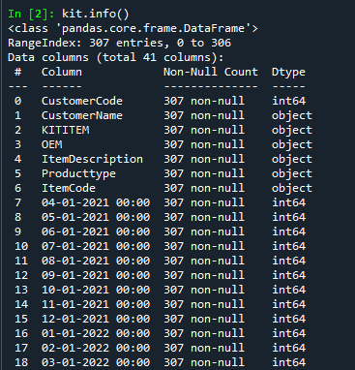
DATA INFORMATION
"Data information" is a broad term that can refer to various aspects of data
In our dataset major of the data types were INTERGER and OBJECT
And there were no null values present in the dataset
The total number of data’s were 307

Slide 11
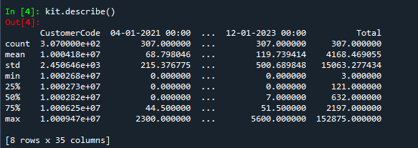
DATA DICTIONARY
In Python, a data dictionary is a way to document and describe the contents of a dataset. It typically includes information about each variable or column, such as its name, data type, description, and any other relevant details. Creating a data dictionary helps maintain clarity and consistency when working with datasets.

Slide 12
SYSTEM REQUIREMENTS
OPERATING SYSTEM: Windows 11 pro
RAM: Corsair Vengence 8gb(*2)
PROCESSOR: Ryzen 5500
GRAPHICS CARD: Gigabyte 1660 Super
SSD: WD 500gb
MOTHERBOARD: Gigabyte b450 dsh3 wifi
SMPS: DeepCool 550w

Slide 13
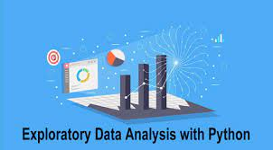
EDA
Exploratory Data Analysis (EDA) is a crucial step in the data analysis process. It involves examining and understanding the characteristics of a dataset to uncover patterns, identify relationships, and gather insights that can inform subsequent analyses. EDA is often performed using statistical graphics, summary statistics, and other techniques.
EDA steps occurred in our dataset are:
INTIAL EXPLORATION
UNIVARIATE ANALYSIS
BIVARIATE ANALYSIS
MULTIVARIATE ANALYSIS
OUTLIER DETECTION
MISSING VALUES
IDENTIFY AND REMOVE DUPLICATES

Slide 14
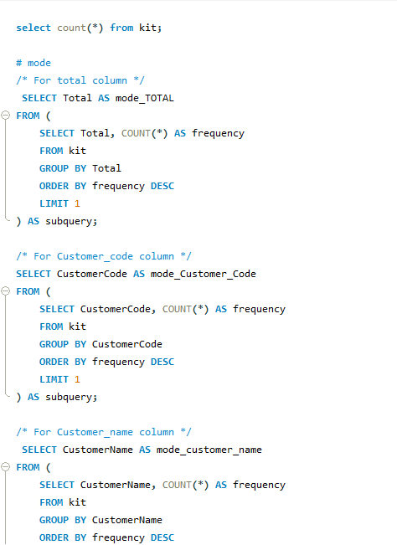
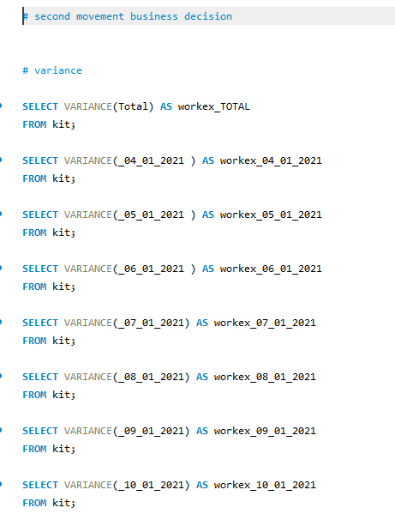
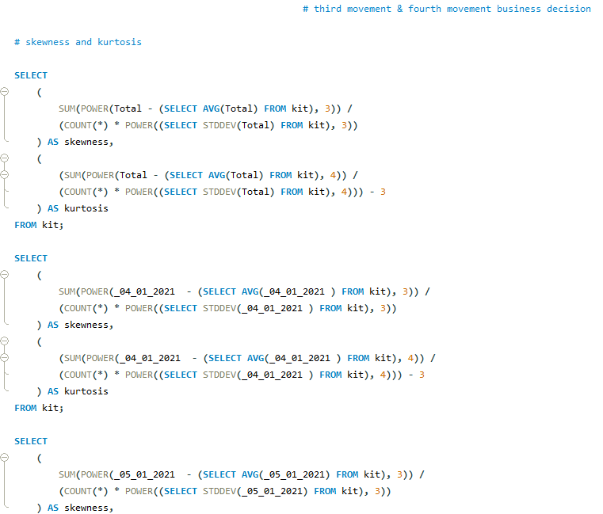
EDA
SQL CODING
14

Slide 15
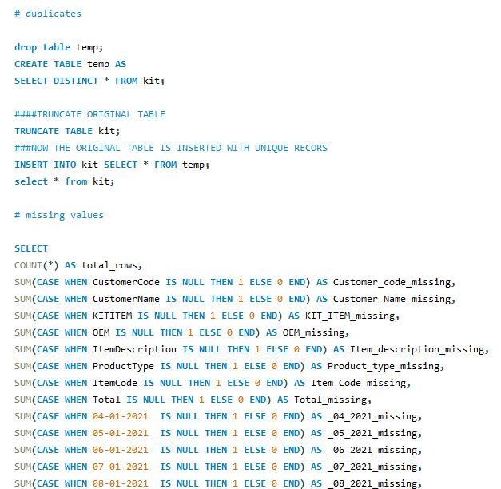
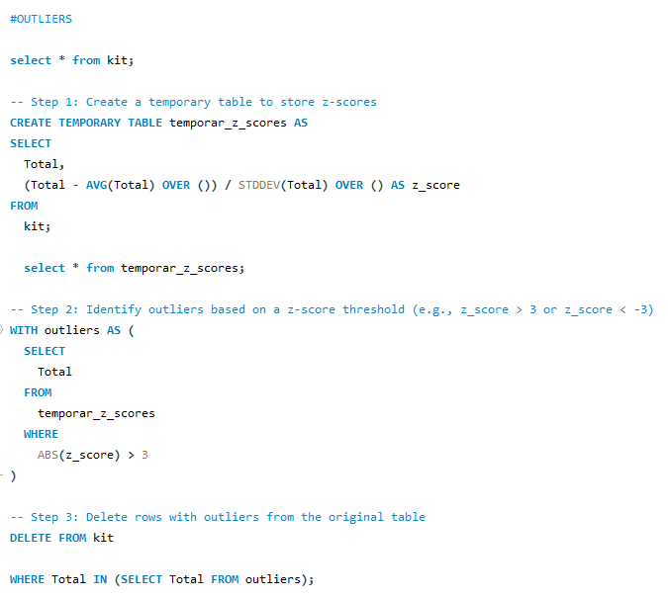
EDA
SQL CODING
15

Slide 16
BEFORE EDA
STATISTICAL INSIGHTS
CATEGORY | VALUES
COLUMNS | 41
ROWS | 307
COUNT | 307
MIN DATE | 1
MAX DATE | 7900
MODE :
CUSTOMER CODE | 10002684
CUSTOMER NAME | CUSTOMER_39
KIT ITEM | KIT0001158
CATEGORY | VALUES
OEM | MANUFACTURE_2
ITEM DESC | M760
PRODUCT TYPE | ENGINE PARTS
ITEM CODE | A020000001
TOTAL :
MEAN | 4168.46906
MEDIAN | 632
MODE | 40

Slide 17
BEFORE EDA
STATISTICAL INSIGHTS
CATEGORY | VALUES
RANGE | 41
VARIANCE | 307
STANDARD DEVIATION | 307
SKEWNESS | 1
KURTOSIS | 7900

Slide 18
BEFORE EDA
BUSINESS INSIGHTS
Analyse the specific products or categories frequently purchased by Customer Code 10002684. This information can guide inventory management, product bundling, and marketing strategies to cater to similar customer preferences.
Focus on customer retention strategies for "Customer_39" to ensure their continued loyalty. This may involve exclusive offers, early access to new products, or membership benefits.
Identify the individual components of "KIT0001158" and analyse which specific items contribute to its popularity. This information can guide inventory management and marketing efforts.
Strengthen your relationship with "manufacturer_2" as they are a significant OEM. This may involve negotiating favourable terms, exploring collaborative marketing efforts, or discussing potential exclusivity agreements.
Highlight and promote "M760" as a featured or popular product in your marketing materials. This can attract customer attention and potentially drive more sales.
Ensure robust inventory management for "Engine Parts" to meet the high demand. Regularly monitor stock levels, optimize reordering processes, and consider predictive analytics to forecast demand accurately.
Ensure robust inventory management for "A020000001" to meet the demand.

Slide 19
AFTER EDA
STATISTICAL INSIGHTS
CATEGORY | VALUES
MEAN | 2650.7096
MEDIAN | 605
MODE | 40
RANGE | 44997
VARIANCE | 34204087.532812685
STANDARD DEVIATION | 5848.42607
SKEWNESS | 4.104641119957992
KURTOSIS | 19.328772160279847

Slide 20
AFTER EDA
BUSINESS INSIGHTS
The mean value of 2650.7096 suggests the average total for the dataset, while the median of 605 indicates a potential presence of outliers pulling the mean higher.
The mode being 40 may signify a common occurrence of this value in the dataset.
The high variance and standard deviation indicate a wide spread of values in the "Total" column.
The large range of 44997 further highlights the variability in the dataset.
The skewness and kurtosis values suggest that the distribution of the "Total" column is not symmetric and has heavy tails.
These statistical insights can guide business decisions, financial planning, and risk management by providing a deeper understanding of the distribution and variability in the "Total" column
Further analysis may be required to identify specific patterns or outliers that could impact business performance.
Additionally, further analysis and exploration could uncover deeper patterns and opportunities within the dataset.

Slide 21
AUTO EDA
Automated Exploratory Data Analysis (Auto EDA) is an approach to data analysis that involves using automated tools and algorithms to explore and analyse datasets without extensive manual intervention. Auto EDA tools are designed to streamline the initial stages of the data analysis process, providing insights into the structure, patterns, and potential issues within a dataset.
Types of AUTOEDA performed in our dataset are:
1.D-TALE
2. SWEET VIZ

Slide 22
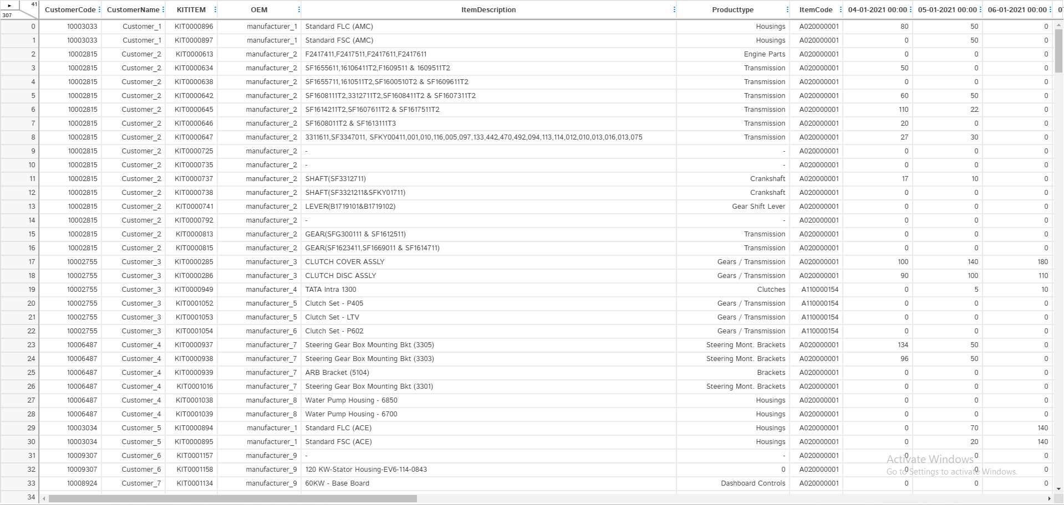
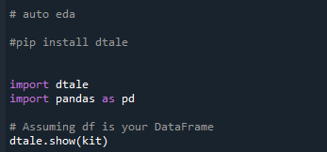
1. D-TALE
D-Tale is a Python library that provides a web-based graphical user interface (GUI) for exploratory data analysis (EDA). It allows users to interactively explore and visualize datasets, making it easier to gain insights into the data's characteristics, patterns, and potential issues. D-Tale is particularly useful for those who prefer a point-and-click interface for data analysis.

Slide 23
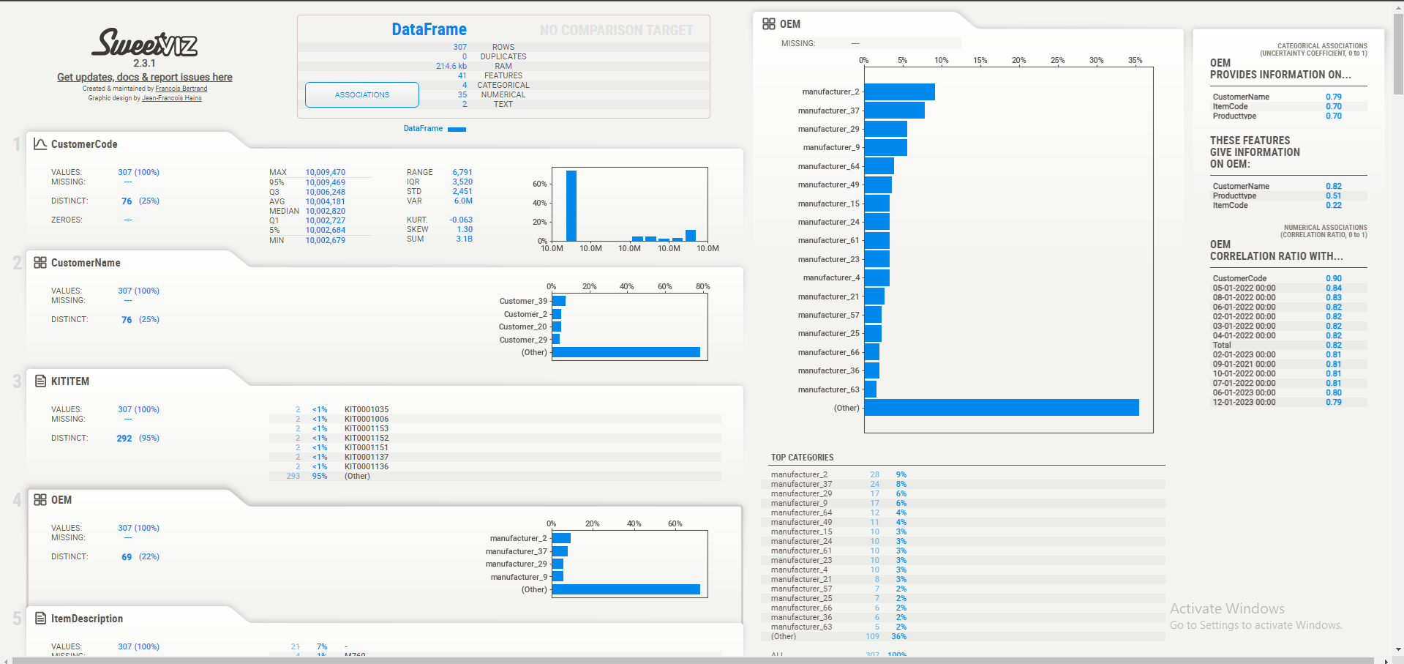
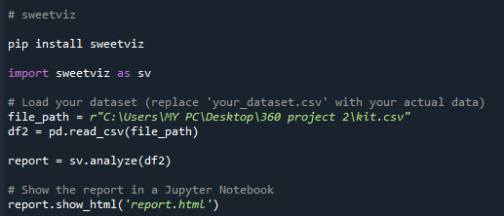
2. SWEET VIZ
Sweet viz is a Python library for visualizing and comparing datasets with a focus on simplicity and automation. It provides high-density visualizations to help users understand the structure and characteristics of their data quickly. Sweetviz is particularly useful for exploratory data analysis (EDA) and can generate detailed comparison reports for two datasets.

Slide 24
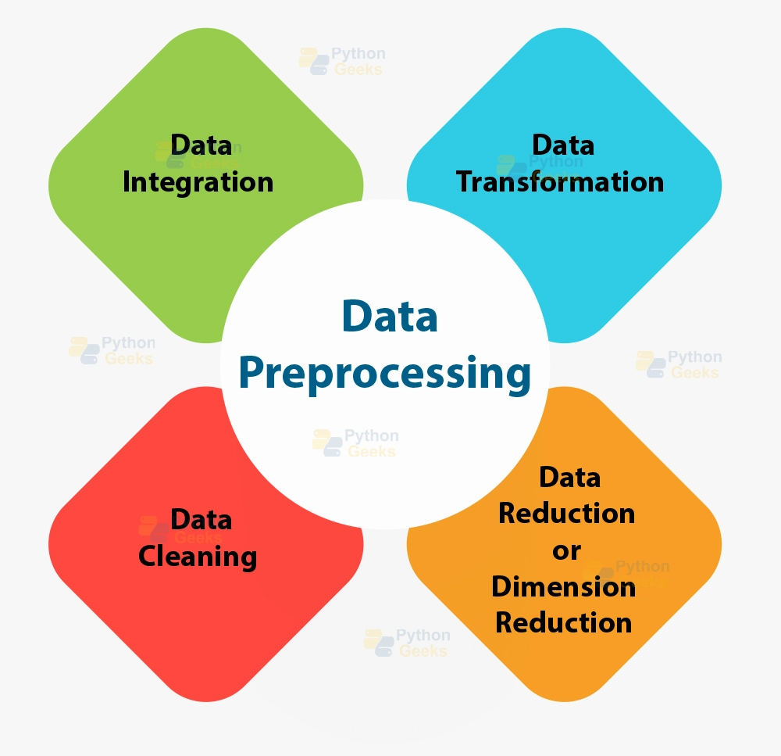
DATA PREPROCESSING
Data pre processing in Python involves a series of steps to clean, transform, and prepare the data for analysis or machine learning
The common pre processing tasks perform in this dataset are:
Handling Missing Values
Handling Outliers
Handling Null Values
Handling Duplicate Values
Handling Type Casting
Handling zero variance & near zero variance
24

Slide 25
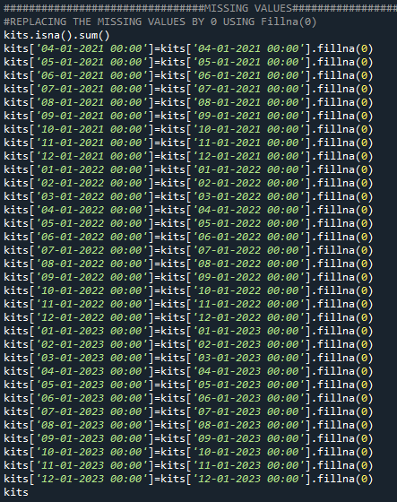
1. HANDLING MISSING VALUES
Handling missing values is a common task in data analysis and machine learning. In Python, there are several libraries and techniques you can use to deal with missing values.

Slide 26
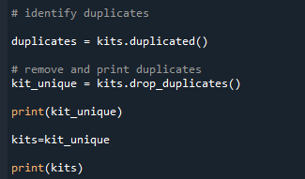
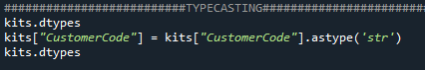
2. HANDLING DUPLICATE VALUES
Dealing with duplicate values is another important aspect of data pre processing. Duplicate values can affect the integrity of your analysis and models.
3. HANDLING TYPE CASTING
Casting, also known as type conversion, is a process that converts a variable's data type into another data type.

Slide 27
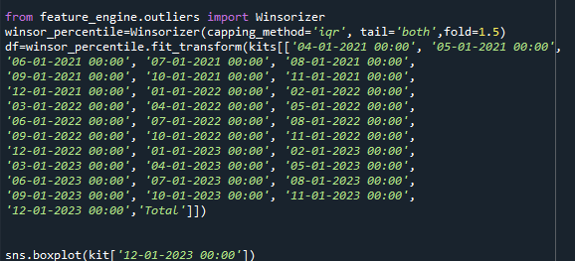
4. HANDLING WINSORIZATION
Winsorizing or winsorization is the transformation of statistics by limiting extreme values in the statistical data to reduce the effect of possibly spurious outliers.
Winsorization is essentially similar to imputing, but instead of imputing extreme values with mean, median, mode, min or max values, we imput those outliers with our chosen percentile. For example, 90% winsorization means the replacement of the top 5% and bottom 5% of the data.

Slide 28
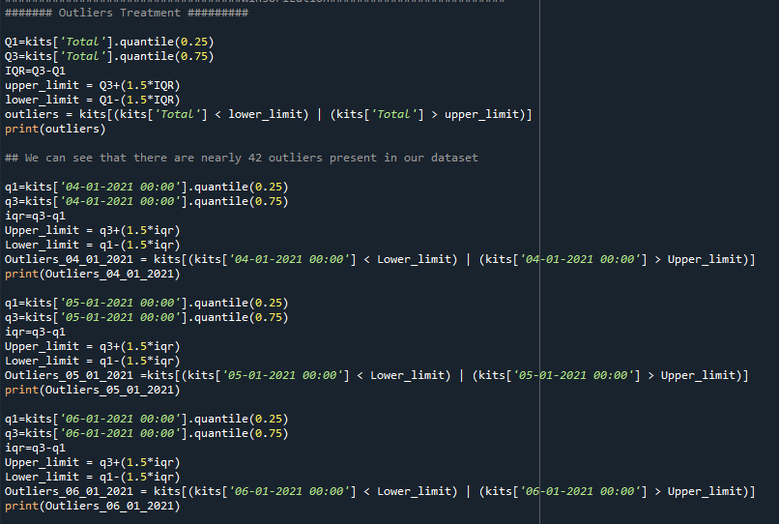
5. HANDLING OUTLIERS
Outliers are data points that deviate significantly from the rest of the data, and they can have a substantial impact on statistical analysis and machine learning models.

Slide 29
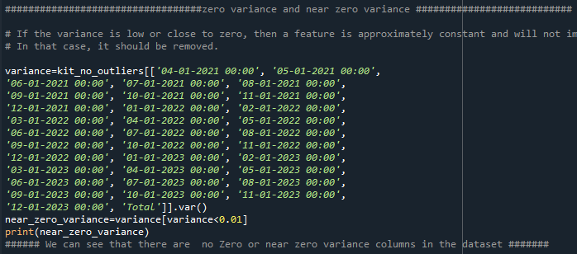
6. HANDLING ZERO VARIANCE & NEAR ZERO VARIANCE
Zero variance means that there is no difference in the data values, which means that they are all the same.
If a variable has very little change or variation, it's like a constant and not useful for prediction. This would have close to zero variance

Slide 30
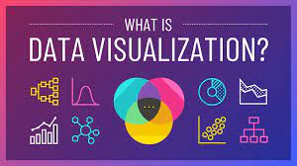
DATA VISUALIZATION
Data visualization is a powerful way to explore and communicate patterns, trends, and insights in your data. In Python, the popular libraries for data visualization are Matplotlib, Seaborn, and Plotly.
Type of Charts used in this dataset are:
Box Chart
Bar Chart
Histogram Chart
Line Chart

Slide 31
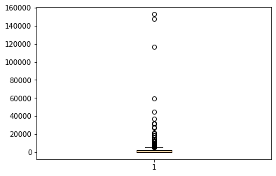
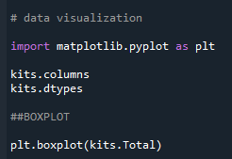
1. BOX PLOT
A box plot is a statistical representation of the distribution of a dataset, showing the median, quartiles, and potential outliers
BOX PLOT FOR TOTAL :

Slide 32
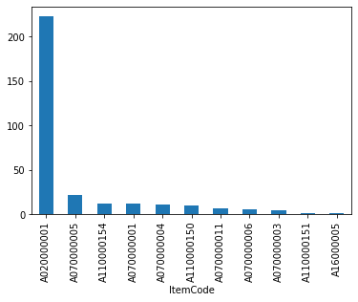
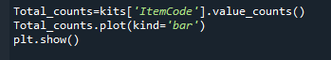
2. BAR PLOT
A bar chart is a common type of chart that presents categorical data with rectangular bars. Each bar's length or height is proportional to the values it represents. Bar charts are useful for comparing the quantities of different categories or for showing the distribution of a single categorical variable.
BAR PLOT FOR ITEM CODE

Slide 33
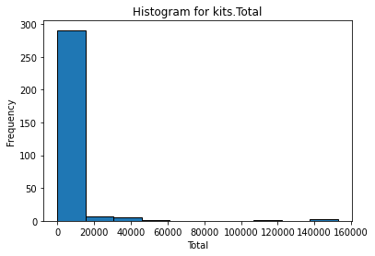
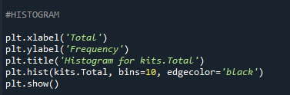
3. HISTOGRAM PLOT
A histogram is a graphical representation of the distribution of a dataset. It shows the frequency of data points falling within specified ranges (bins). Histograms are commonly used to visualize the underlying probability distribution of a continuous variable
HISTOGRAM PLOT FOR TOTAL :

Slide 34
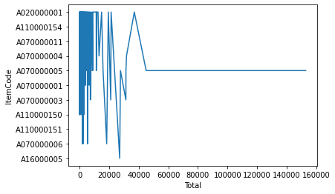

4. LINE CHART
A line chart is a type of chart that displays data points connected by straight line segments. It is often used to visualize the trends or patterns in time-series data or to show the relationship between two continuous variables
LINE CHART FOR ITEM CODE :

Slide 35
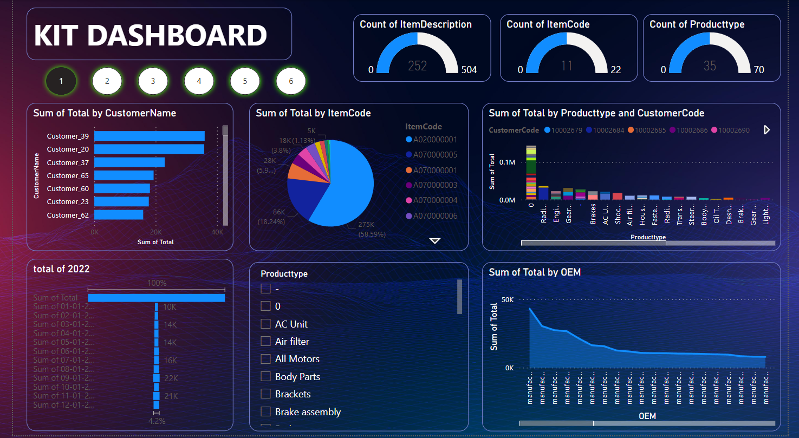
POWER BI DASHBOARD

Slide 36
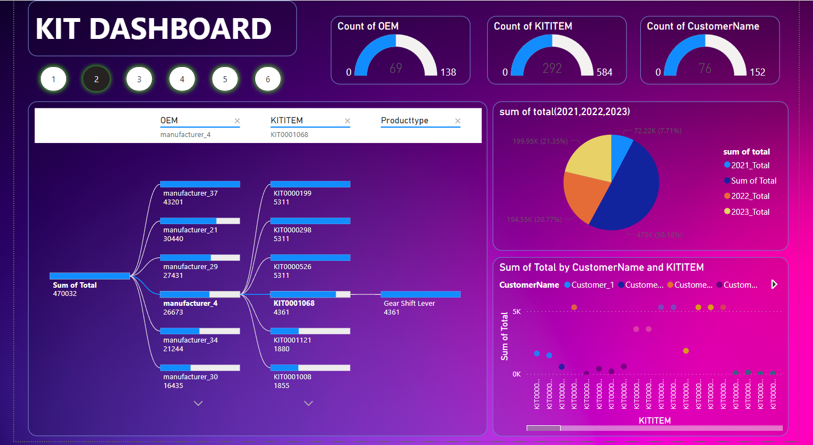

Slide 37
POWER BI INSIGHTS
SUM OF TOTAL BY CUSTNAME
CUSTOMER_39 is the top customer
CUSTOMER_62 is the lower customer
SUM OF TOTAL (2021,2022,2023)
Sum of total of 2023 is 21.35% is the highest year
Sum of total of 2022 is 20.77% is the second highest year
Sum of total of 2021 is 7.71% is the least year
SUM OF TOTAL BY CUSTNAME AND KITITEM
The sum of total of top value of customer is 5311in kititem
The sum of total of least value of customer is 23 in kititem
SUM OF TOTAL OF OEM, KITITEM, PRODUCTTYPE
The sum of total is 470032 and selected by manufacture_4 is 26673 and selected by kit 0001068 and the product type is gear shift lever
SUM OF TOTAL BY PRODUCT TYPE , CUSTCODE
The custcode 10002684 have the total sum of 32129 of product radical intercoolers
The custcode 10002690 have the total sum of 4258 of product suspension
SUM OF TOTAL BY ITEMCODE
The sum of total by itemcode which a020000001is the highest percentage of 58%
The sum of total by itemcode which a110000051 is the lowerst percentage of 0.45%

Slide 38
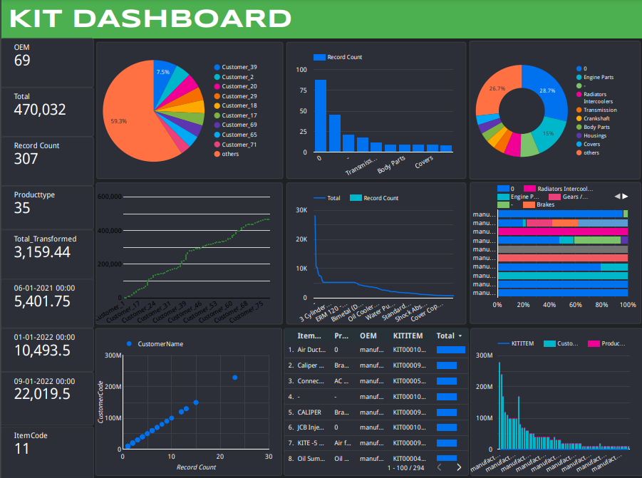
GOOGLE DATA STUDIO DASHBOARD

Slide 39
Thank you

